Slide 1
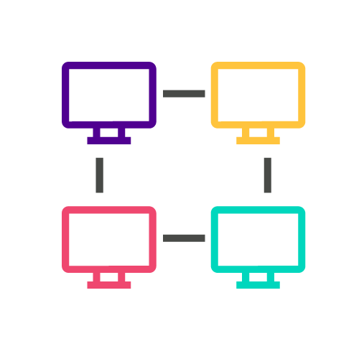
COLT-X: The Use of AI for Network Automation and Network Optimization
Colt Technology Services
Berkeley Innovation X-Labs
Sutardja Center for Entrepreneurship & Technology
Notes:
Isabel (10 sec)
Hello and welcome to the final presentation of the Berkeley Innovation-X Labs project in collaboration with Colt Technology Services. We’re very excited to share our progress over the past couple of months.

Slide 2
Appendix
About Colt
What Colt Provides
Project Scope
Objective
Technical Phases
System Architecture
Low Tech Demo
Platform Selection
UI Requirements
Final Demo
Technical Components
Technology Strategy
Project Timeline
Next Steps
Future Work
Reflections
Meet the Team
Skylight Performance
Notes:
Isabel
Here is an appendix that we added with all the contents of this presentation for future Innovation-X teams to refer to as they potentially continue this project.

Slide 3
About Colt Technology Services
Provides world-class network & voice connectivity to businesses in Europe, Asia & the US
Connects 900+ data centres across Europe, Asia & North America
Takes advantage of emerging technologies (i.e. SD-WAN, 5G deployments, or uCPE)
Notes:
Isabel
Let’s start off with a brief overview of Colt’s background.
Colt is a multinational telecommunications company headquartered in the UK. It transforms the way the world works through the power of connectivity and provides a world-class network and voice connectivity to businesses in Europe, Asia and the US. It has been leading the industry for over two decades.
Colt IQ Network connects 900+ data centres across Europe, Asia and North America's largest business hubs, with over 29,000 on net buildings and growing, which is more than any other network provider.
It also takes advantage of emerging technologies (i.e. SD WAN, 5G deployments, or uCPE)

Slide 4
What Colt Provides
Capital market solutions
Optical network and ethernet services
On Demand network solutions
Services
Internet, SD WAN, & IP VPN
Cloud & data center services
Cybersecurity services
Notes:
Isabel
Here are a couple of services that Colt provides for its users ranging from capital market solutions to cloud and data center services.

Slide 5
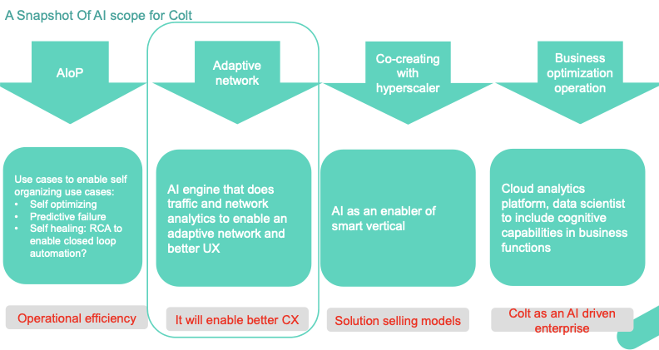
Snapshot of AI Scope from Colt
Notes:
Isabel
While Colt has worked on a variety of projects, from co-creating with hyperscaler to business optimization operation, our group was responsible for the second project in this diagram related to adaptive networks. Throughout the past couple of months, we established an early phase of an adaptive AI network that measures and controls network traffic an from application to deliver an improved customer experience on the server, which can be applied to other applications in the future.

Slide 6
Objective: Dynamically Set Bandwidth in AR/VR Applications
01
02
03
Network Traffic Data
Analyze network traffic behavior and hourly changes
Dynamically Set Bandwidth
Provide bandwidth levels over an hourly period throughout each day
SLA Characterization
Tell characterization and pull what the application is doing
Notes:
Isabel
Our project uses network traffic data to make suggestions for the amount of bandwidth that can be added between locations using quality of service measures and dynamically characterized service-level agreements. These SLAs represent the relationship between the service provider and client.
Our final algorithm takes in the flow and loss of network traffic and current network settings and returns the adjusted network settings with the optimal bandwidth, but allowing it to measure and characterize dynamic service-learning agreements (SLA) for different applications would be the next step for future versions.
I’ll now pass it onto Noor to provide a more in depth explanation of the project’s system architecture.

Slide 7




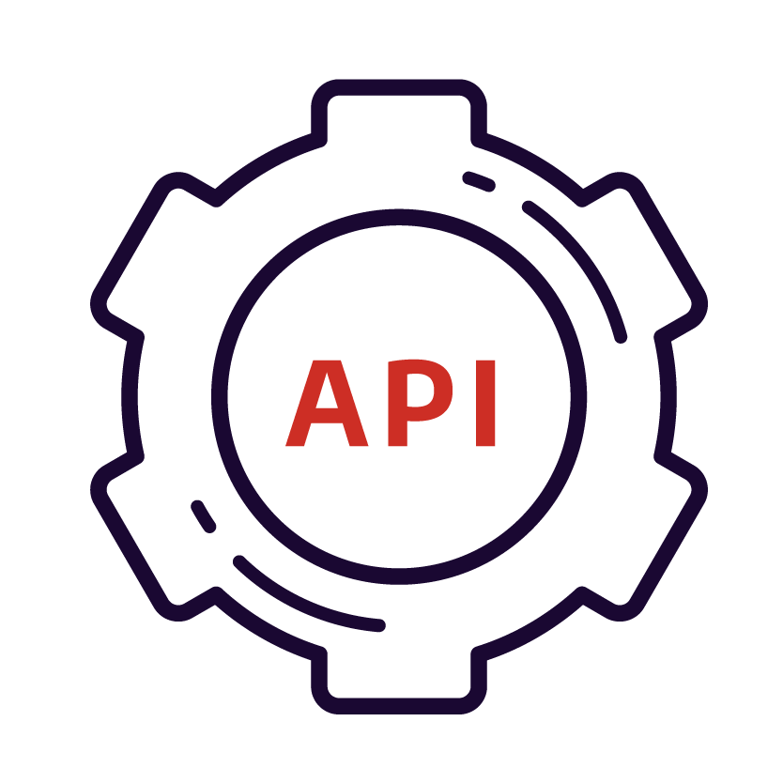










System Architecture: Colt Application-Centric Network
Skylight Performance Analytics (Accedian)
COLT Novitas Portal: On-Demand Live Portal
(Bandwidth changes)
https://ondemand.colt.net
Algorithm Prototyping:
Optimized bandwidth
Dynamic SLA Mathematical Computations
Stats including mean, variance, etc.
Statistical Multiplexing (see application)
Storage:
Short: Apache Zeppelin (Python/R)
Long: .csv files
Existing UI Interface used by Colt
Data extraction
MEASURE
CONTROL
Phase 1&2 PROCESSES
Feedback from Colt
OUTPUT: SERVER
New settings (Bandwidth)
Graph of network and measures of current Quality of Service (QOS)
Network delays experienced on link
Display the measurement and characterization of Dynamic SLAs
INPUT: APPLICATION
Network traffic data collected from probes placed against AR/VR applications
Log event data
LINK Pipeline (Bandwidth)
Notes:
Noor (2 min)
The system architecture for the Colt-X project was created to align with Colt’s application-centric network. The lower left side is the application and the lower right side is the server. The application and server is connected by a link that serves as a pipeline. This contains the bandwidth as part of the network settings. In this pipeline is where our project is relevant, shown in the blue cloud.
The input for our adaptive network engine is the log event files of network traffic data for the relevant AR/VR application. The data is gathered by probes placed against the application in the network. We extracted the data from the existing UI used by Colt which displays performance analytics. The performance analytics are used to measure the behavior of the particular application on the link we are looking at.
We also have access to the Novitas portal where we can control the real time effect of changing bandwidth in the test environment. Both these tools supported our project in phase 1 of showing the network traffic and original bandwidth settings and characterizations along with optimized bandwidth suggestions.
The results from our algorithm will be sent to the server showing graphs of the network traffic and measures of QOS to independently monitor and provide suggestions for optimized bandwidth settings, creating an adaptive network.

Slide 8
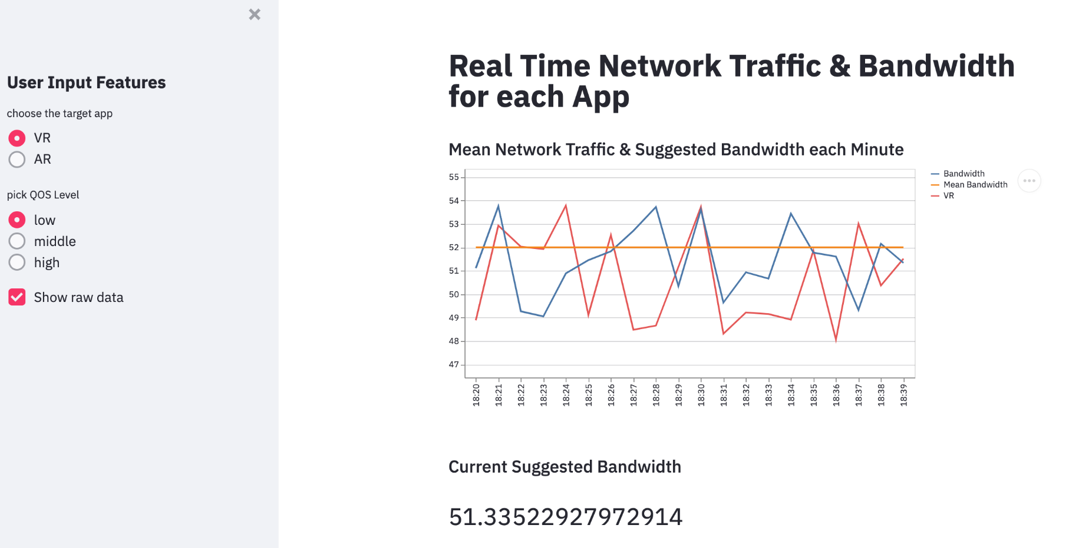
Low Tech Demo
Notes:
Noor
The user interface you see is from our low tech demo created using Streamlit. Our objective was to use the low tech demo as a first version to align with Colt on what information would be valuable for their intended use. Features included network traffic settings, picking quality, and pulling network traffic information.
The Colt user perspective shows network settings on a line plot. The lines represent traffic flow in one minute intervals and the horizontal line is the bandwidth. Anything above the bandwidth limit is considered loss. The plot displays the original bandwidth and the new optimized bandwidth along with suggested bandwidth based on average mean packet loss in one minute intervals.

Slide 9
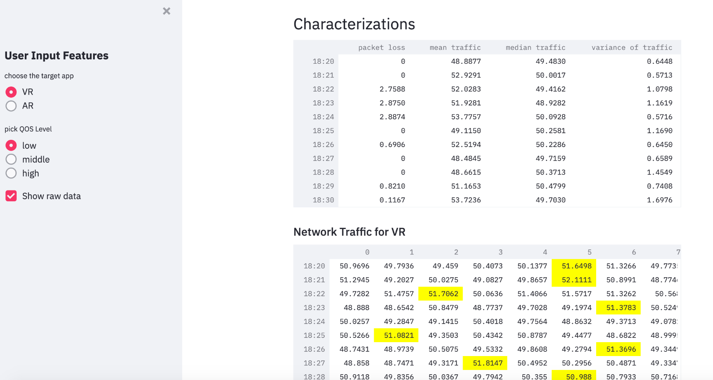
Low Tech Demo
Notes:
Noor
Part of our low tech demo displayed the characterizations of network traffic over one minute intervals. Some include packet loss mean median and variance of traffic.
The network traffic for each selected application is also displayed. The highlighted numbers are the highest values for each one minute interval which inform what to set the bandwidth as.
The low tech demo was created using publicly available sample data from kaggle.

Slide 10
Platform Selection
Need from platform:
UI that displays automatic network bandwidth settings through data visualizations and dynamic characterizations of SLA
Front-end web application using Python
Allows the user to upload data files
Deployed anywhere
Collaborative through Git version control or generating a shareable link
Free license for Berkeley students or staff
Feasible with Jupyter
Why Anvil?
Notes:
Charline
To display the user input and output features of network bandwidth settings and characterizations, we selected Anvil, which is a front-end web application that uses Python and offers a variety of useful features. The platform allows the user (Colt) to upload data files - in this case, Colt would be able to upload network traffic data files and connect existing algorithm settings through the overall implementation of the UI.
Anvil can also be deployed anywhere, it’s collaborative through Git version control or through generating a shareable private link, and it offers a free license for Berkeley students or staff. Most importantly, it’s feasible with Jupyter, which is relevant for future X-Labs scholars through coursework and projects.
I’ll now pass it back to Noor to give an overview of our UI requirements.

Slide 11
UI Requirements
Allows for csv file uploads
Chooses the target app from VR to AR
Picks QOS level from low to high (1-5)
INPUT
User Interface
OUTPUT
Determines a new bandwidth
Shows mean network traffic of the current bandwidth per minute on a line graph
Displays tables for characterization & VR network traffic
Notes:
Charline
The requirements of our UI include csv file uploads of the network and application data, a selection of target applications from VR to AR, and a QOS level feature from acceptable to best (1-5). We implemented all of these features in our second phase of the UI and can compute a new and optimized bandwidth over a given period of time through simple mathematical computations. These calculations are informed by the QOS level and adjust the output of the line representing optimized bandwidth on the graph accordingly.
Once all the csv files have been uploaded, display tables for characterization and VR network traffic are also created below the charts.

Slide 12
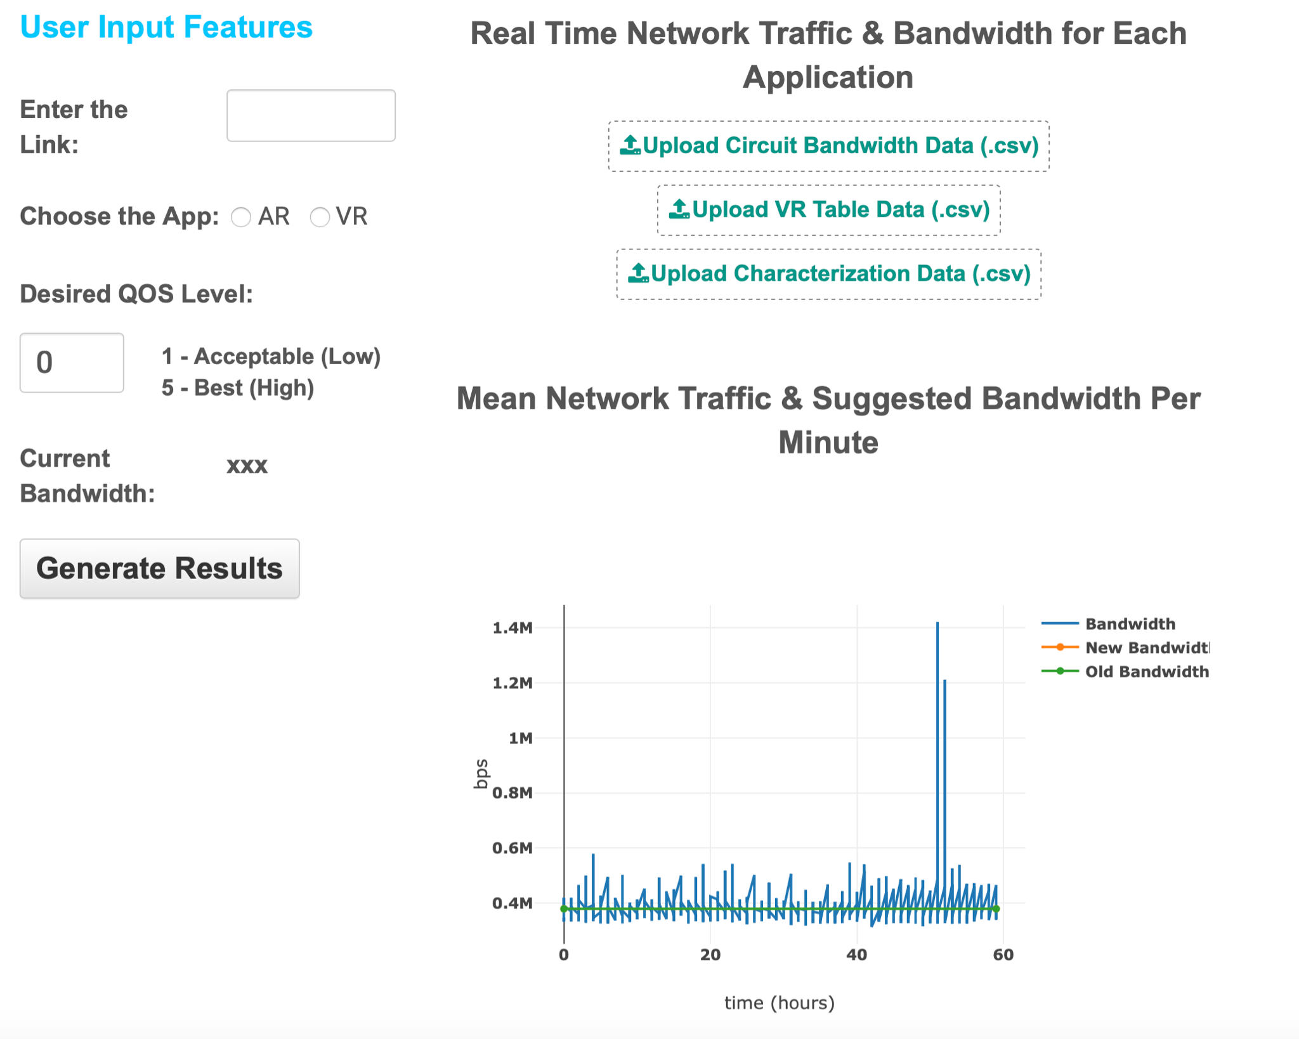
Final Demo
Mathematical Computations
QOS =
Low → β=1 → μ + 1*σ
Mid → β=3 → μ + 3*σ
High → β=5 → μ + 5*σ
Notes:
Noor
The demo of our dynamic bandwidth recommendation application for Colt is running locally on our web browser.
The visualization of network traffic and original bandwidth along with the optimized bandwidth suggestion is generated from circuit bandwidth, characterization, and network traffic data we accessed from Skylight Analytics- through Colt’s analytics partner Accedian.
The optimized bandwidth is determined by a QOS measure from 1 to 5 corresponding to some beta value 1 to 5. This beta value is multiplied by the standard deviation and added to the mean of the network traffic to determine what percentile to set the optimal bandwidth to- shown by the orange line.
As Isabel will now demonstrate the orange line will change based on the desired QOS level entered by the user. The link and relevant application features are not functionally implemented as that is for Colt’s user perspective to select the a link that makes up the network and the relevant application on that link. We have included a hover feature that indicates the functions that are fully implemented.
As part of the algorithm setting the dynamic recommendation system returns the original bandwidth and optimized bandwidth in bytes per second.
The data tables show the characterizations including average minimum and maximum of network delay and traffic information for the VR stream application on the link we are looking at.

Slide 13
Technical Components
Order of importance:
Python and relevant libraries (matplotlib, plotly, numpy scipy, etc.)
Technologies for UI component: Streamlit, Anvil, Git
DEMO with analytics partner (Accedian): real time effect of changing bandwidth performance in test environment
Access to available data through Skylight Analytics (Accedian)
UI component: Valuable information to display based on Colt’s preferences
Algorithmic prototyping and mathematical computations. Resource: Ikhlaq Sidhu
Green & Orange: Easy to develop
Red: Learning required (complete)
Notes:
Peter
Our technical components have been updated with the addition of the Anvil platform used for creating our app using Python.
The main components which informed our application were information about Colt’s that would be valuable for them and accessing the relevant data.

Slide 14


Technology Strategy Analysis
Platform | Flexibility & Speed of Iteration | Ease of Use / Learning Curve | Performance | Overall Rating
 | Quick | easy; documents; basic python coding | good for data analysis & display; lacks powerful UI features | 7
 | Quick | medium; video & docs; more components (client codes) | good for heavy backend code; more features; average UI | 9
Notes:
Peter
We used Streamlit to show our first version of Colt’s user perspective to ensure our goals for the project aligned. Once we confirmed user input features and output features of our application we used Anvil to implement it.
Both Streamlit and Anvil are quick when it comes to speed and flexibility. As we went through multiple iterations Anvil did take some time to load when generating visualizations- that was to be expected when changing input for desired QOS.
Streamlit is easier to navigate and easily creates data visualizations with minimal coding. One con of Anvil is the UI is not as clean or minimal as Streamlit but the higher functionality of backend code and ability to deploy a web application coded in Python is why we chose Anvil.
In our project we relied heavily on Anvil’s available documentation.

Slide 15
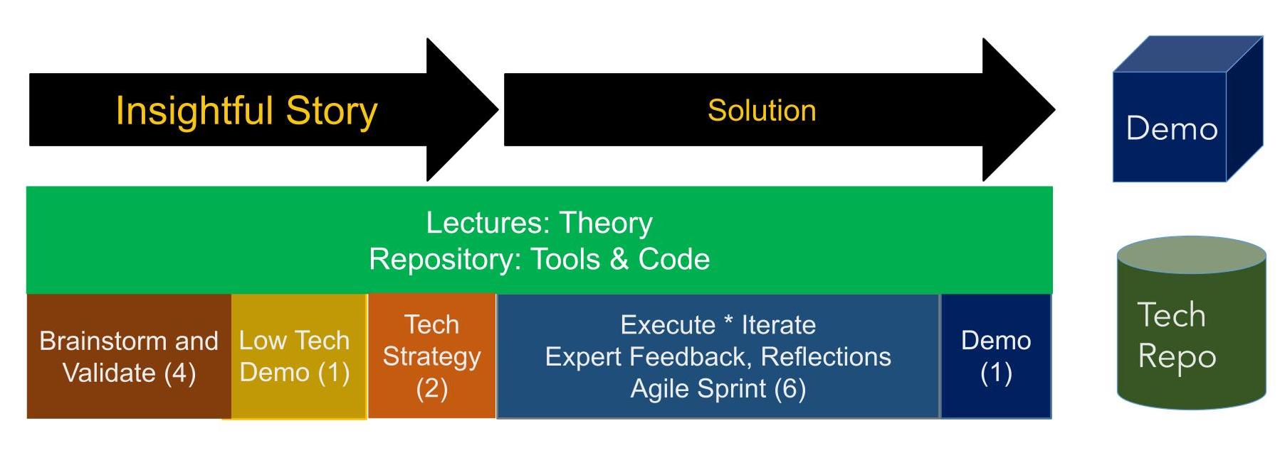
Project Timeline
Brainstorm/Project Story with Colt Mentor (Week 1)
Low Tech Demo v1 (Week 2)
Low Tech Demo v2 (Week 3)
Technology Strategy (Week 4)
Low Tech Demo complete with tech strategy v3 (Week 5)
Execution in 4 Weekly Sprints (Week 6-10)
Demo, Presentation, and Scope of next project (Week 11)
Final Demo, Presentation, and Scope of next project (Week 12)
Notes:
Peter
Herer is the project timeline, and we used the Innovation Engineering methodology to structure our project framework.
As shown in our demo, we completed our technology strategy of a web-based UI application using Python to show network traffic and original bandwidth settings along with our optimized bandwidth suggestion.
Although our project timeline has come to an end, Ronel will now share more details about the next steps future teams can take to continue this project.

Slide 16
Next Steps
Completed (Phase 1)
Information about network traffic data and performance
Uploading Circuit Bandwidth table, VR table, Characterization data
Link
AR/VR app selection
Desired QOS Level
Current Bandwidth
Mean Network Traffic & Optimized bandwidth suggestion Per Minute graph
Network Traffic Table for VR
Characterization Table
Next Steps (Phase 2)
Some features not functionally implemented
Link
AR/VR app selection
Writing tests to check how quickly the bandwidth should change based on model recommendation
Map what QOS setting equates to low and high quality AR/VR service
Notes:
https://anvil.works/build#clone:WFUL66I32H4E7CDH=DW3P3JFWHII4VMGTBBBXKTD2
Ronel(45 sec)
Part of developing technical phases of the Colt project is setting it up for future X-Labs scholars to pick up on.
Future work on continuation of this project through future X-labs scholars includes using AR/VR application traffic data and mapping what QOS setting (or what Beta value) equates to a low and high quality of service, Adding Links to get csv data from websites, and Writing tests to check how quickly the bandwidth should change based on model recommendation

Slide 17
Algorithm 2.0: Future Work
Connect the network to application through link- not functionally implemented
AR/VR application selection display (if multiple apps on one link)
Filtering csv files- should display data for any timeframe
How often you readjust: if the model says to re-adjust it how quickly does it go up and down
Algorithm test that pulls the bandwidth down and checks it against current setting
Show through dotted line on graph
Characterization (what a 3 vs 1 means) in terms of AR/VR stream app
Map what QOS setting equates to low and high quality AR/VR service
Characterization and measurement of dynamic SLA
Notes:
Ronel(45 sec)
To dive deeper, the next Algorithm should Connect the network to application through the link. The AR/VR application selection display should show multiple apps on one link, should display data for any timeframe by filtering data allowing flexibility, should adjust the model by having the Algorithm test pulls the bandwidth down and checks it against current setting and should show through dotted line on graph. Also, they should add Characterization and measurement of dynamic SLA in terms of AR/VR stream app to Map what QOS setting equates to low and high quality AR/VR service.

Slide 18
Reflections
What we learned, what was unexpected, takeaways from project experience, etc.
Notes:
Isabel
Colt-X was one of the first Berkeley Innovation-X projects bridging academia with industry practice. It was also Colt’s first experience collaborating with an educational institution. Our innovation-X student team spent the past 11 weeks creating an adaptive network to automatically suggest an optimal bandwidth based on network settings and desired QOS measures.
We built a system architecture to define the project scope informed by Skylight network performance Analytics to be implemented in the pipeline from AR/VR applications to Colt network servers. We also designed and analyzed a technology strategy using traffic shaping from our technical mentor Deb, who is the Senior Director of SWE at Intel.
In addition to iterating on the front end Python application shown in our demo, we co-created a dynamic team environment through the Innovation X-Labs where we learned relevant technical skills, but also formed professional relationships to learn and apply computing and data science methods to the telecommunications industry, which was a field none of us had prior experience working in. It was extremely eye-opening to see how such a large company operates on a day to day basis while providing a wide array of services to the public.
Besides gaining tremendous insight within this industry, this applied research internship project taught us about the Innovation Engineering methodology and how to practice it beyond academic coursework. We are extremely grateful to have had the opportunity to work with both Colt Technology Services and Berkeley’s Innovation-X Lab and will eagerly apply what we’ve learned to future projects.
Ronel:
Learned different versions of our UI. This helped see difference between the UI’s. Learned how companies operated
Extracted data from Accedian Skylight Analytics platform
Designed technology strategy informed by network traffic shaping demo from mentor
Iterated on front end web application in Anvil

Slide 19






Meet the Innovation-X Team
Isabel Zavian
Management Lead
B.A. Economics & Data Science
izavian@berkeley.edu
Noor-Ul-Ain Ali
Technical Lead
B.A. Data Science
noorulain@berkeley.edu
Ronel Solomon
Technical Member
B.A. Data Science
ronelsolomon@berkeley.edu
Charline Shen
Intern
B.A. Computer Science & Physics
tingweishen@berkeley.edu
Andy Lam
Intern
B.S. Mechanical Engineering
alam9414@berkeley.edu
Peter Li
Intern
B.A. Applied Math & Computer Science
lixingyu@berkeley.edu
Notes:
Isabel
This is our Innovation-X team with 6 students total. Thanks to the entire group for all time and effort they’ve dedicated to the project.

Slide 20

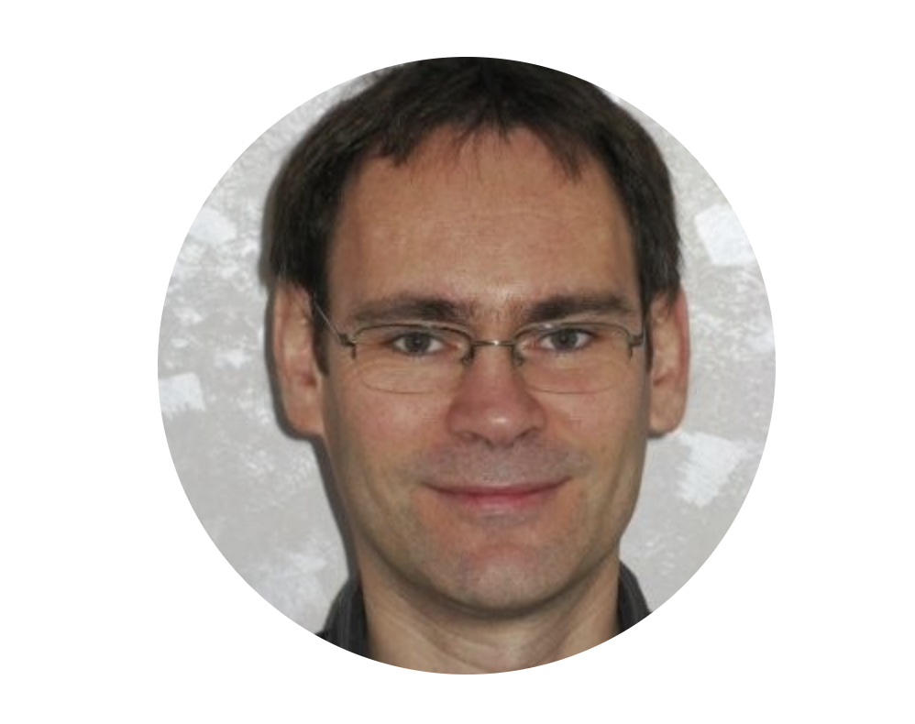




Advisors
Francesca Serravalle
Emerging Technology Director
COLT Technology Services
Valéry Augais
Network Architect
COLT Technology Services
Elisa Balestra
Project Manager
Berkeley Innovation-X Labs
Debashis Chatterjee
Senior Director of Software Engineering
Intel Corporation
Ikhlaq Sidhu
Founding Chief Scientist & Faculty Director
Sutardja Center for Entrepreneurship & Technology
Jennifer Nice
Director of Industry & Alumni Relations
Sutardja Center for Entrepreneurship & Technology
Notes:
Isabel
A special thank you to our advisors and mentors for all the support throughout the past couple of weeks. Some of the our team members couldn’t make it today due to time zone conflicts, but we would like to acknowledge everyone who has been a part of this project.

Slide 21
Thank You!
Do you have any questions?
Innovation-X: https://innox.berkeley.edu
Colt: https://www.colt.net
Notes:
Isabel
Thank you for following our progress in the Colt-X project over the summer. We are now open to any feedback and questions you might have.

Slide 22
Skylight Performance Analytics
Accedian Documentation

Slide 23
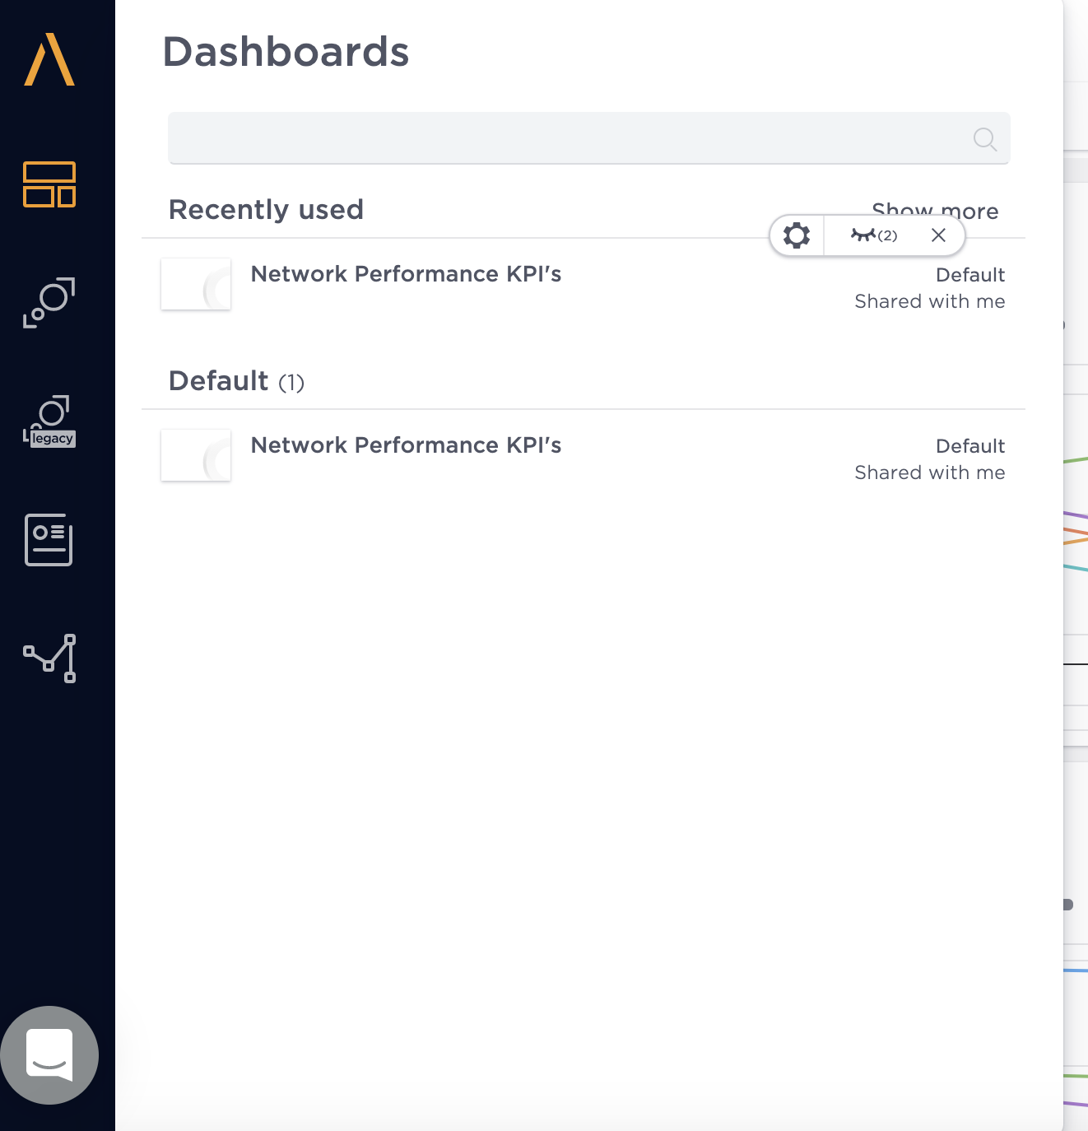
Choose a Dashboard
You can first choose your main dashboard in the Monitoring section.

Slide 24
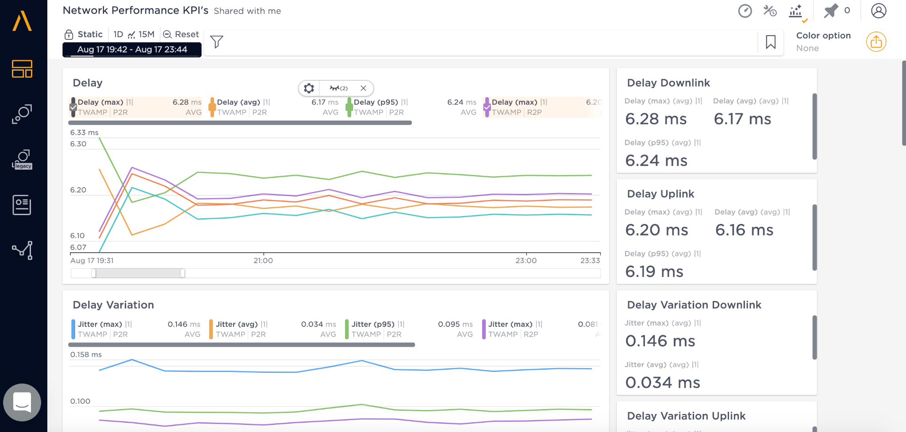
Main Dashboard
Change the time zone here
Zoom the graph here
List of characterizations

Slide 25
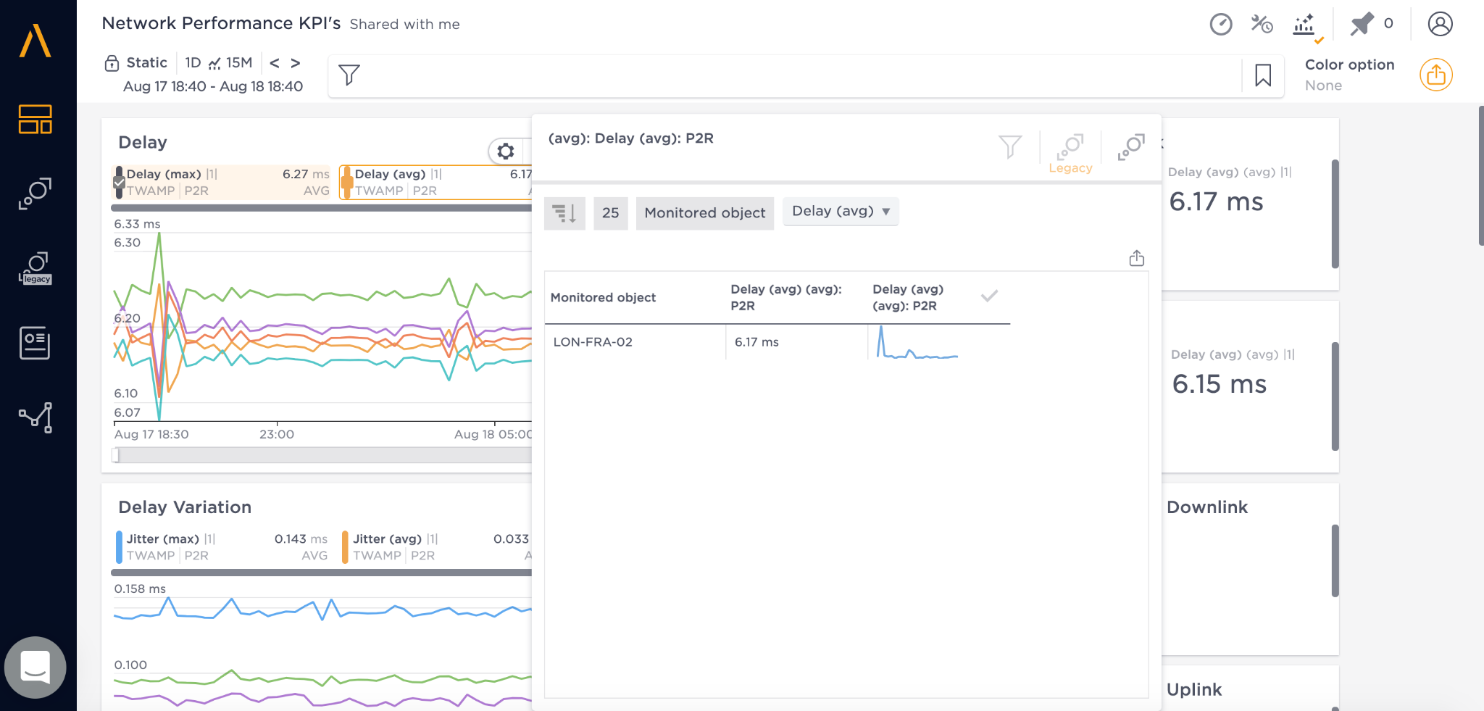
Main Dashboard
Click on the arrow on the right of any metric block to expand
Click on the monitored object to look closely at the object’s data & metrics.

Slide 26
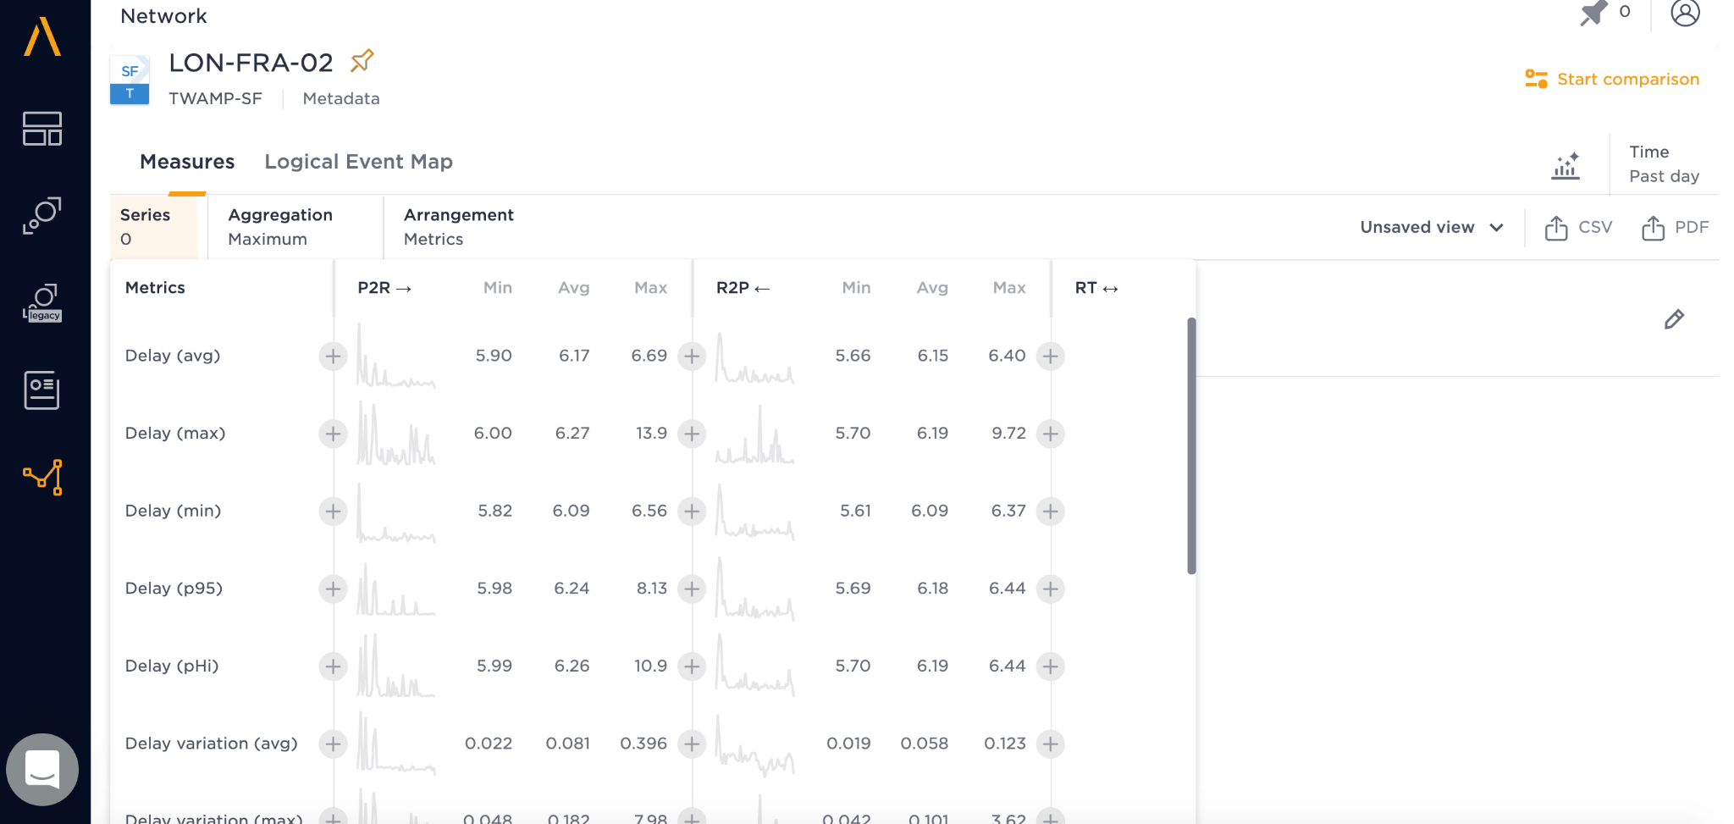
In a Network Object
Inside a target network object, we can click on Series Button and add the metrics we want by clicking the “+” button beside.

Slide 27
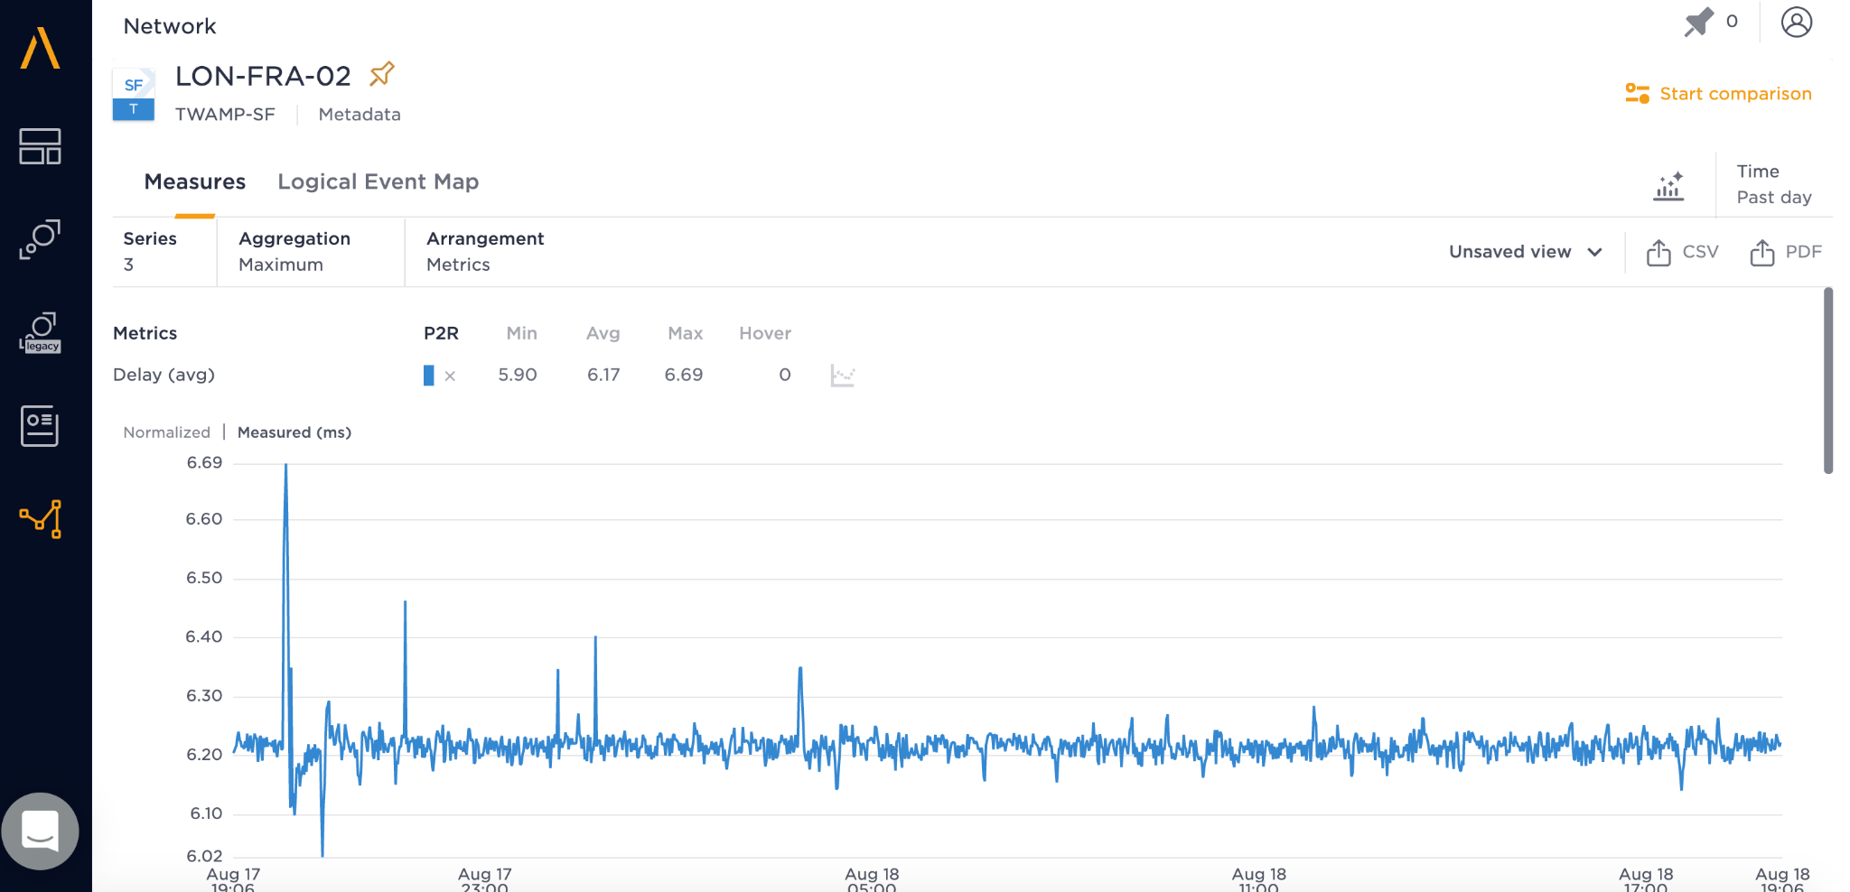
In a Network Object
After adding the metrics, you can download the csv/pdf data here.

Slide 28
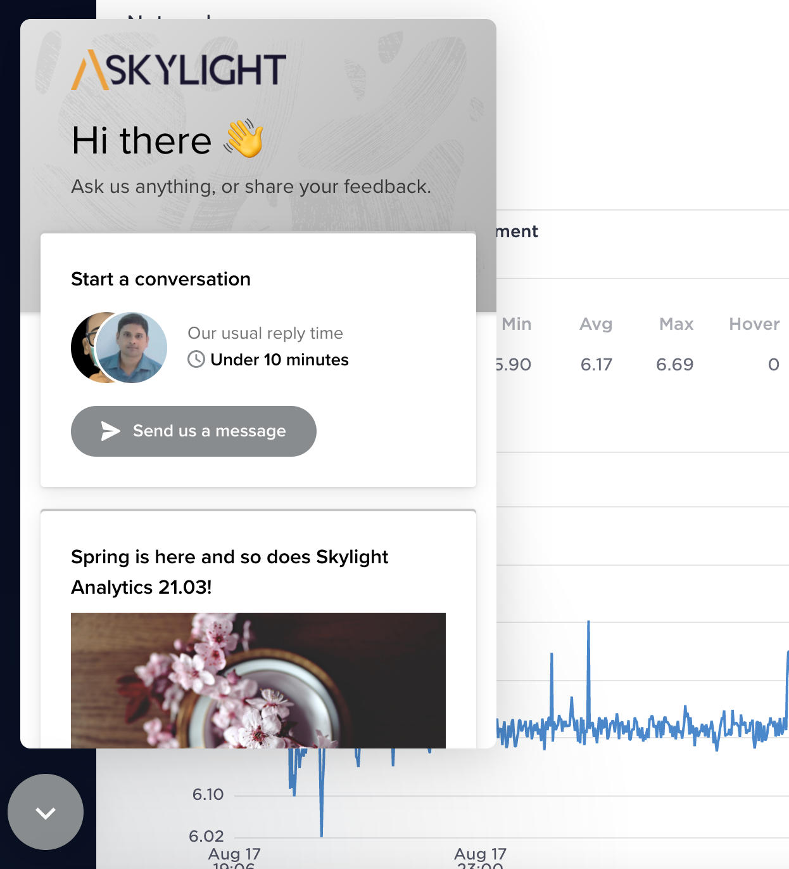
Chat Window
You can click on the arrow at the bottom left corner to talk with Skylight staffs.

